Slide 1



SALESDASHBOARD (1)
View in Power BI
Last data refresh:
4/26/2025 3:56:10 PM UTC
Downloaded at:
4/28/2025 10:45:17 AM UTC

Slide 2
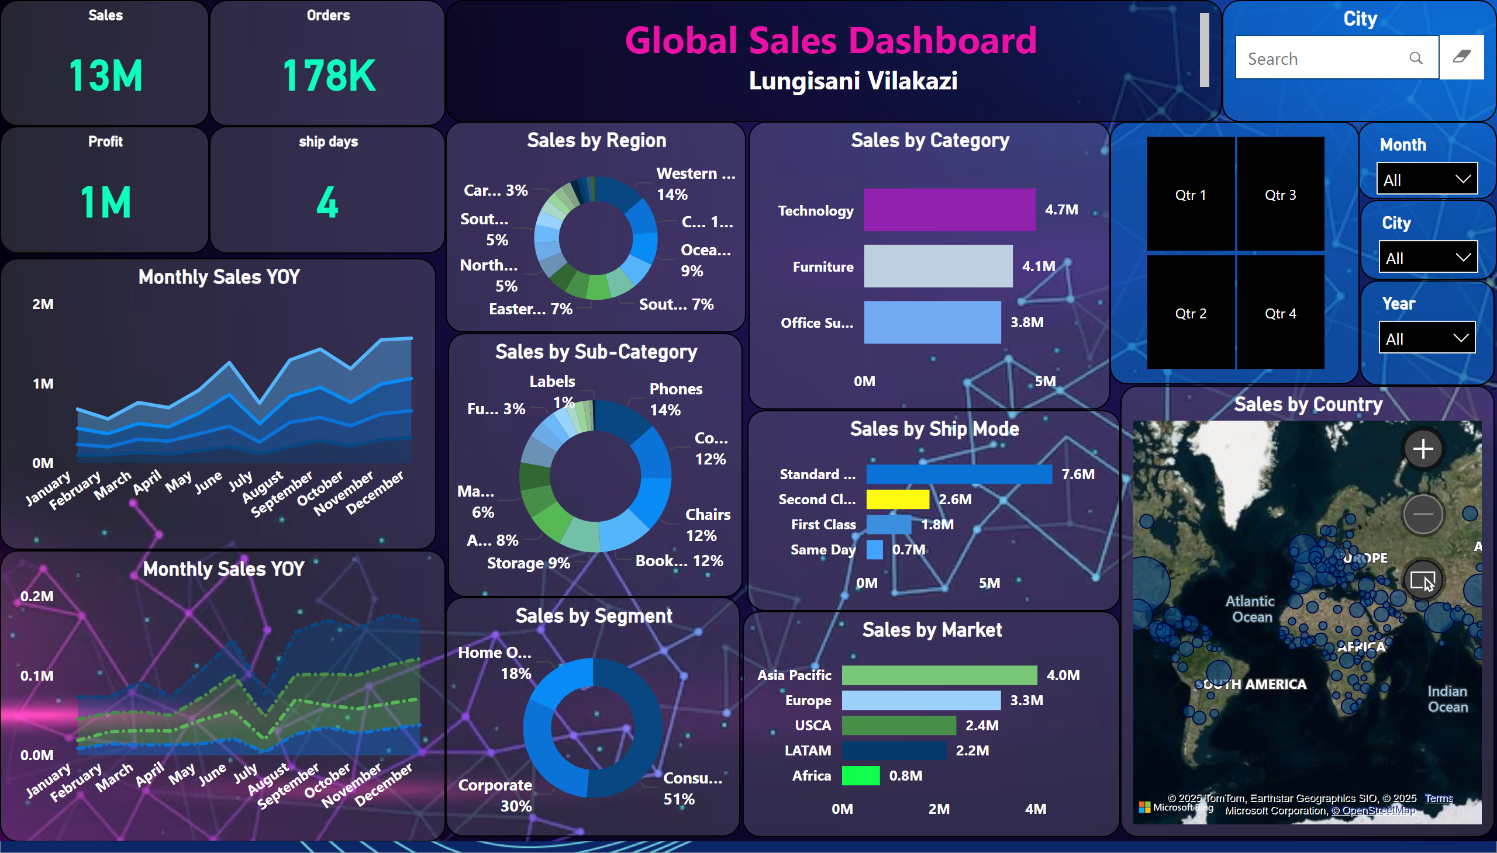
Sales Dashboard
Notes:
Sales by Category
No alt text provided
Sales by Ship Mode
No alt text provided
Sales by Market
No alt text provided
Sales by Country
No alt text provided
Monthly Sales YOY
No alt text provided
Monthly Sales YOY
No alt text provided
textbox
No alt text provided
Sales by Sub-Category
No alt text provided
Sales by Region
No alt text provided
Sales by Segment
No alt text provided
Orders
No alt text provided
Sales
No alt text provided
Profit
No alt text provided
ship days
No alt text provided
slicer
No alt text provided
slicer
No alt text provided
slicer
No alt text provided
slicer
No alt text provided
textFilter25A4896A83E0487089E2B90C9AE57C8A
No alt text provided

Slide 3
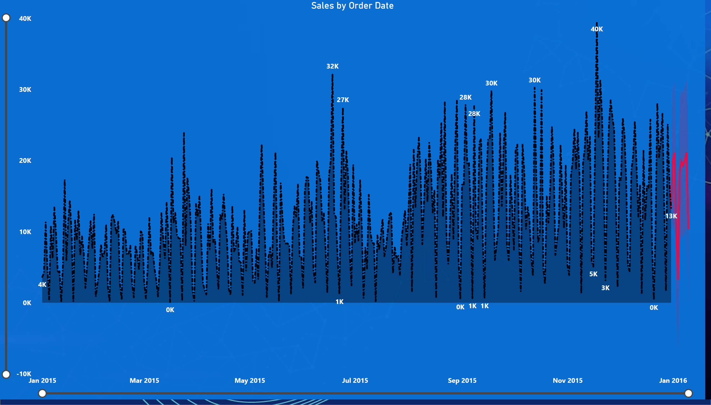
Forecast
Notes:
Sales by Order Date
No alt text provided

Slide 4
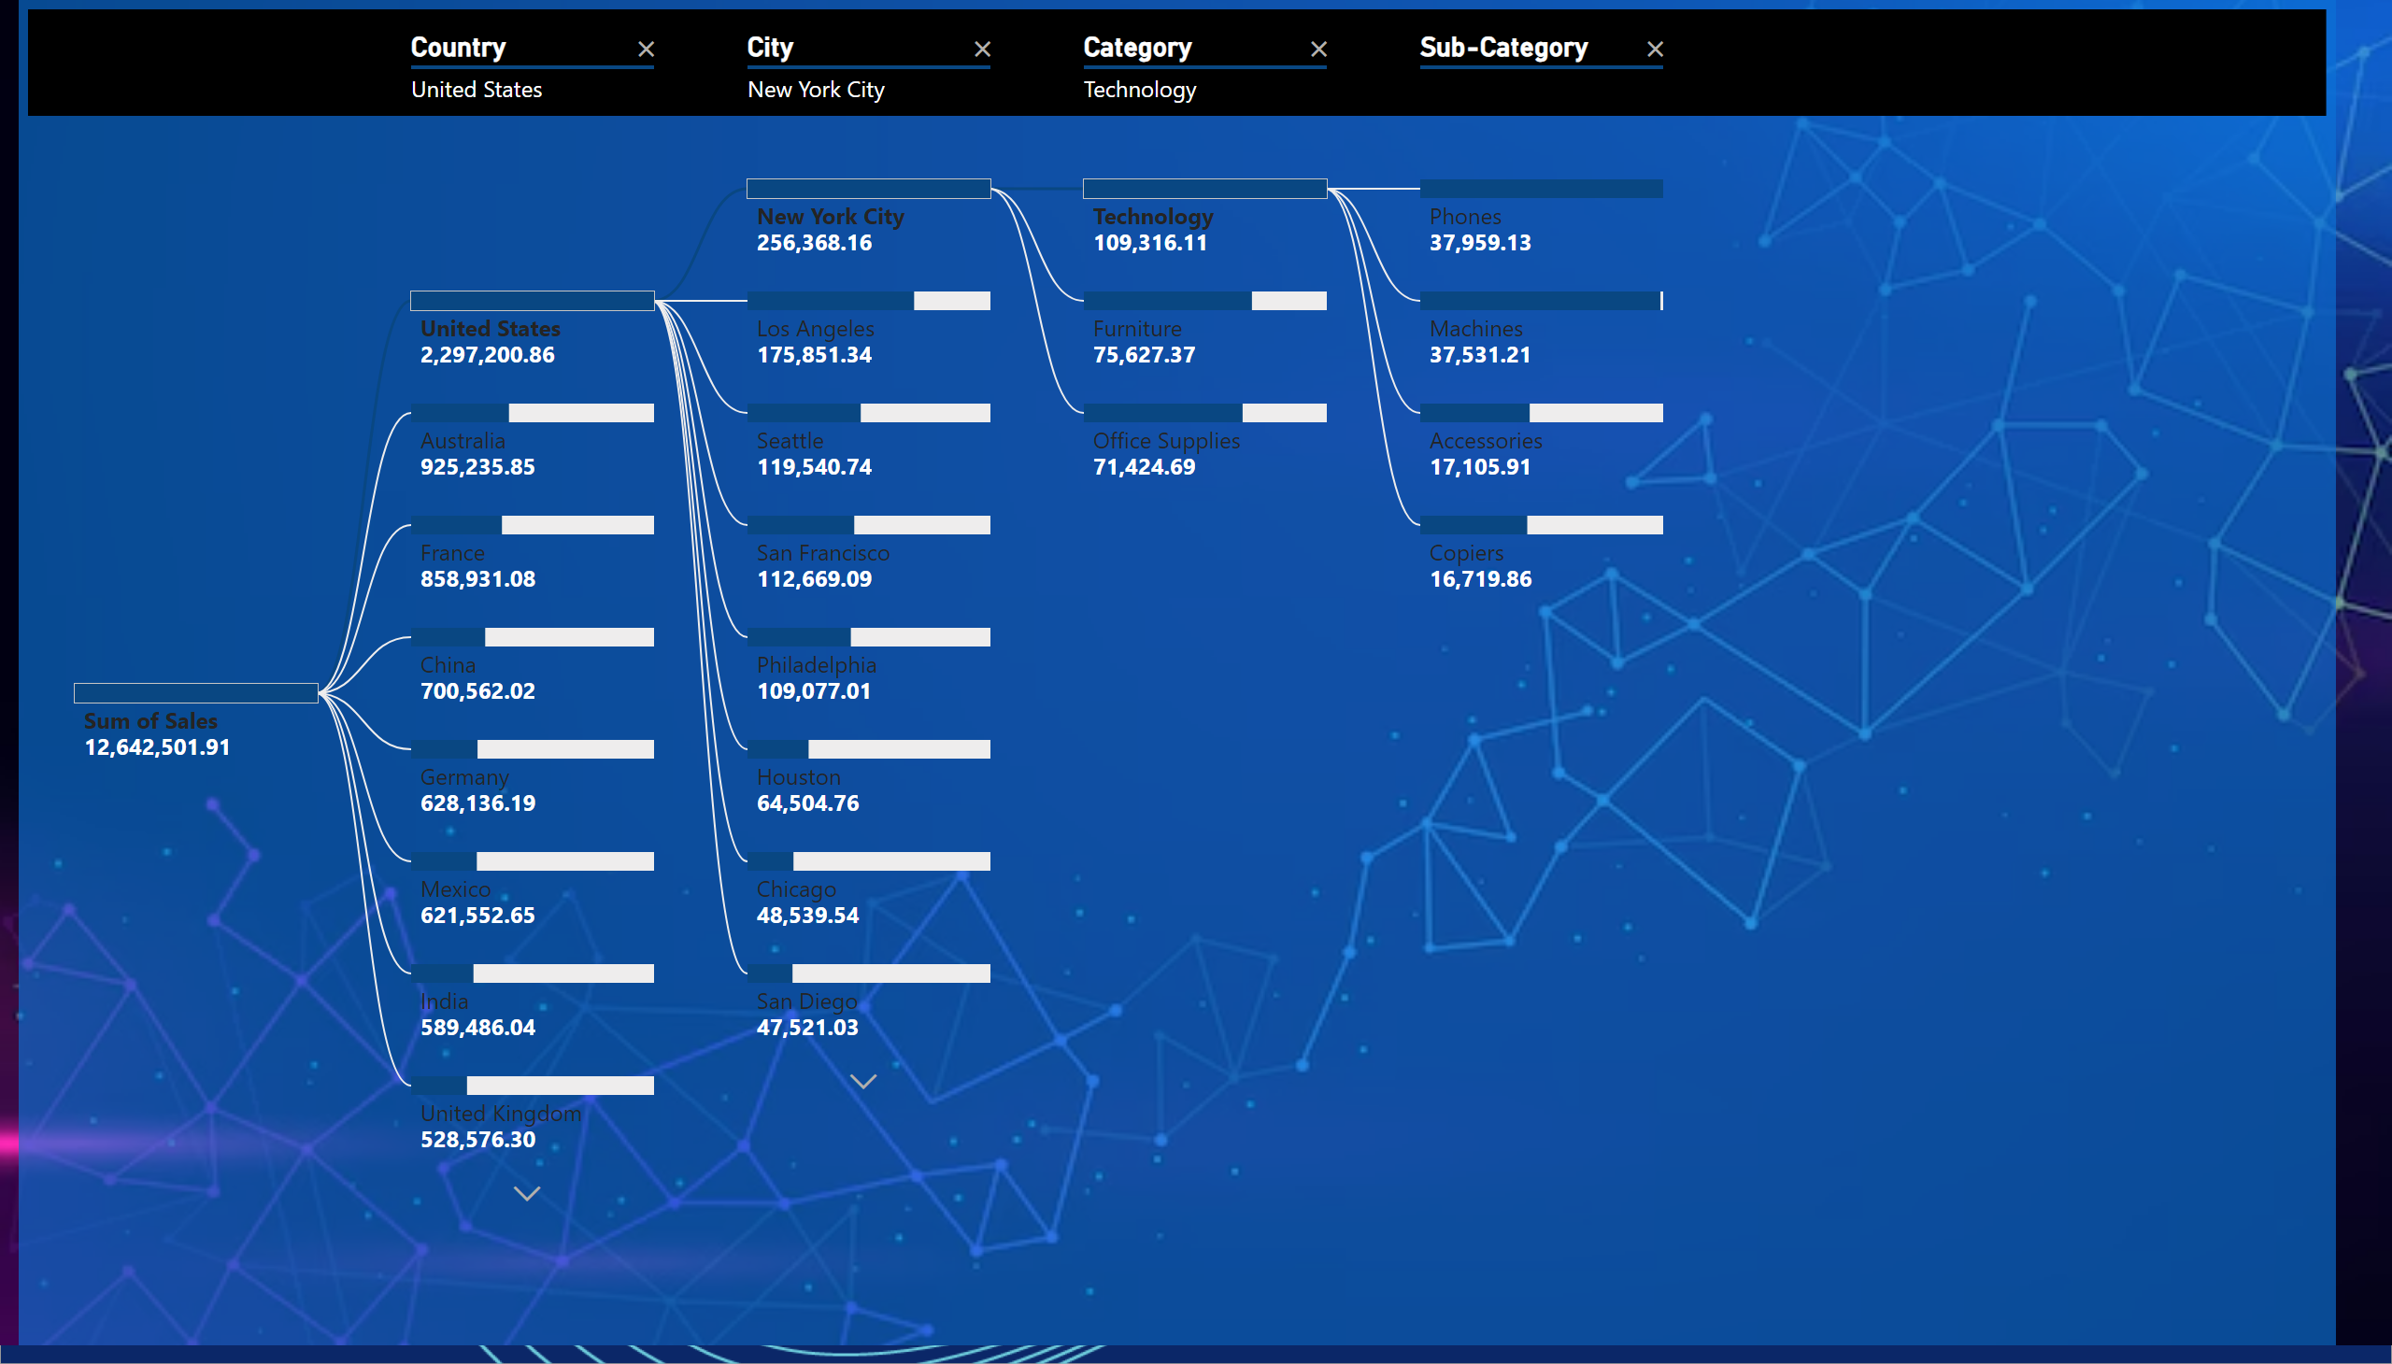
Decomposition
Notes:
decompositionTreeVisual
No alt text provided

Slide 5
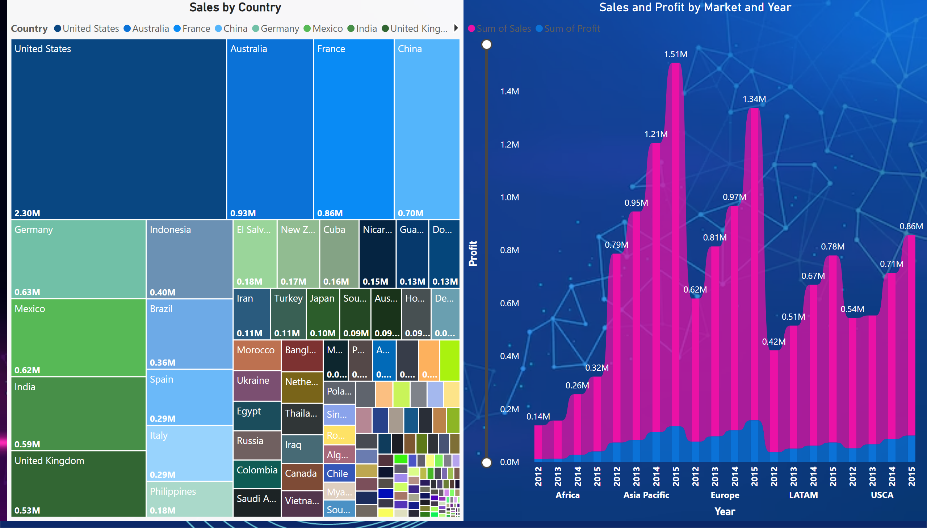
Comparison
Notes:
Sales by Country
No alt text provided
Sales and Profit by Market and Year
No alt text provided

Slide 6
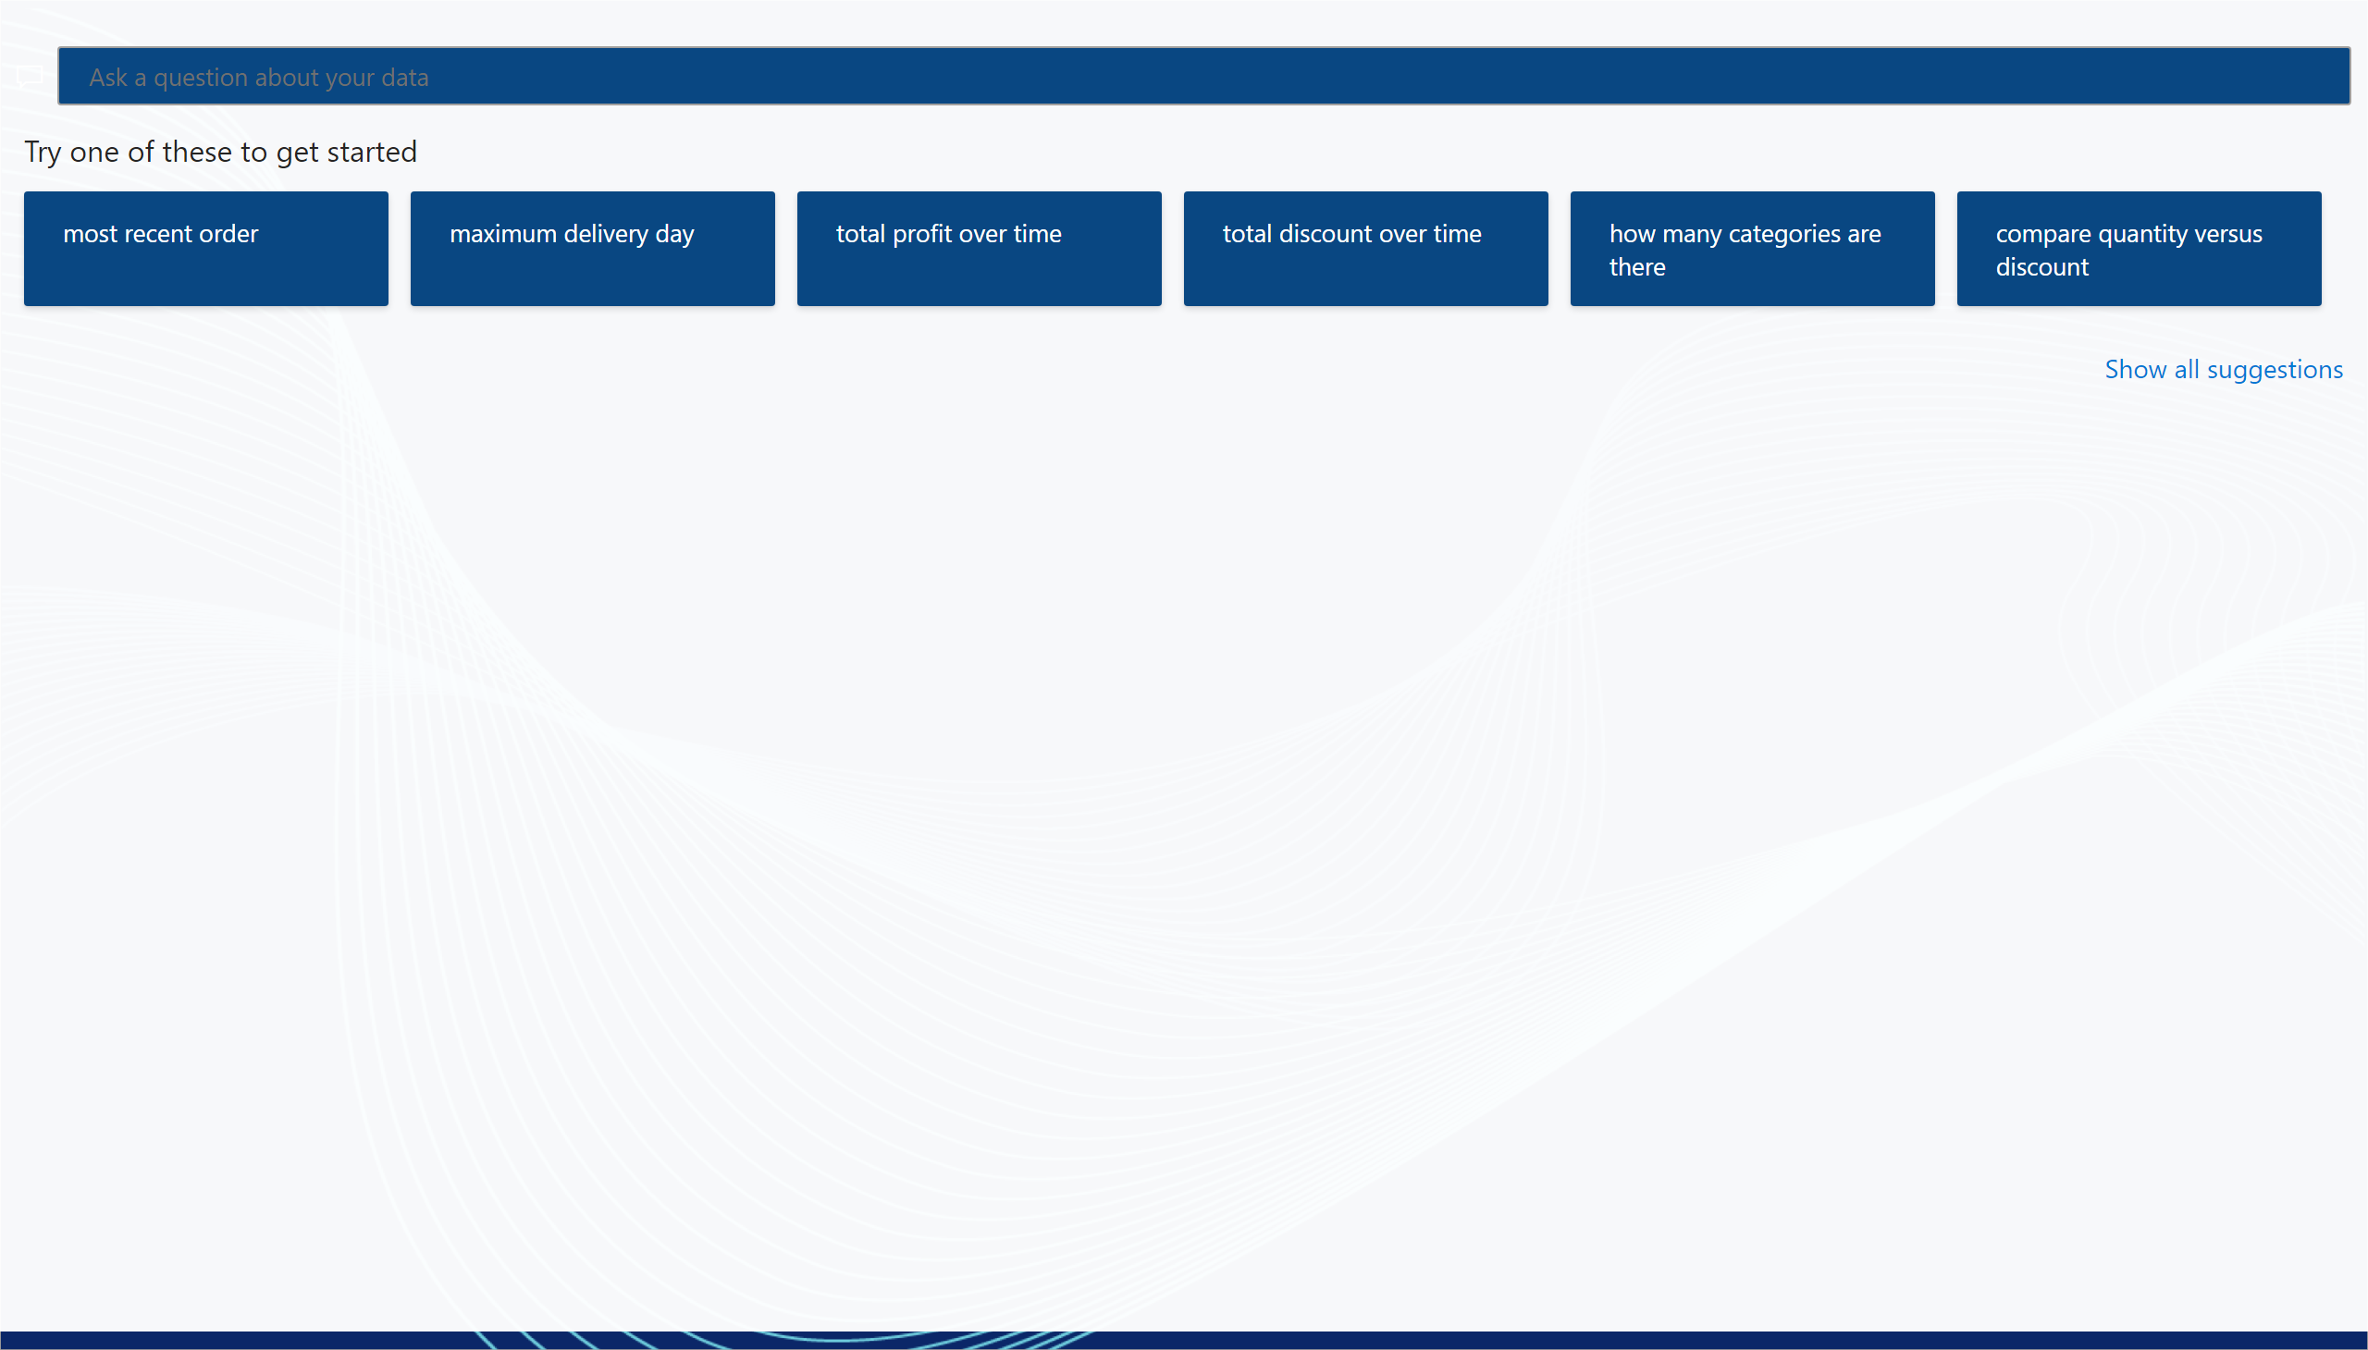
Q+A
Notes:
qnaVisual
No alt text provided

